Slide 1


Exadata: Architecture and Internals
Gurmeet Goindi
Master Product Manager, Exadata
Twitter: @ExadataPM
Notes:
All Speaker Notes are Oracle Confidential – Internal Only
Analogy to Exadata being “in the lead”

Slide 2
Notes:
This is a Safe Harbor Front slide, one of two Safe Harbor Statement slides included in this template.
One of the Safe Harbor slides must be used if your presentation covers material affected by Oracle’s Revenue Recognition Policy
To learn more about this policy, e-mail: Revrec-americasiebc_us@oracle.com
For internal communication, Safe Harbor Statements are not required. However, there is an applicable disclaimer (Exhibit E) that should be used, found in the Oracle Revenue Recognition Policy for Future Product Communications. Copy and paste this link into a web browser, to find out more information.
http://my.oracle.com/site/fin/gfo/GlobalProcesses/cnt452504.pdf
For all external communications such as press release, roadmaps, PowerPoint presentations, Safe Harbor Statements are required. You can refer to the link mentioned above to find out additional information/disclaimers required depending on your audience.

Slide 3
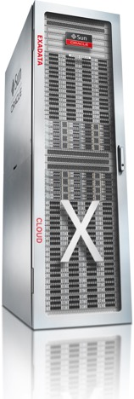
Exadata Database Machine
Performance, Availability and Security
Best Platform for Oracle Databases on-premises and in the Cloud
Enabled by:
Single-vendor accountability
Exclusive focus on databases
Deep h/w and s/w integration
Revolutionary approach to storage

Slide 4























Proven at Thousands of Critical Deployments since 2008
OLTP – Analytics – Data Warehousing – Mixed Workloads
4 of the top 5
Banks, Telcos, Retailers run Exadata
Best for all Workloads
Petabyte Warehouses
Online Financial Trading
Business Applications
SAP, Oracle, Siebel, PSFT, …
Massive DB Consolidation
Public SaaS Clouds
Notes:
Banks (Reibanks list)
ICBC
HSBC
CCBC
BNP
JPMC
Ag Bank of China
Bank of China
Credit Agricole
Barclays
Deutsche Bank
JPMC
Retailers (Forbes list)
Walmart
CVS
Home Depot
Walgreens
Target
Costco
Carrefour
Tesco
Telcos (GSMA list)
China Mobile
Vodafone Group
China Unicom
Telefonica Group
America Movil Group
Orange
AT&T
China Telecom
Airtel
SingTel
Axiata

Slide 5
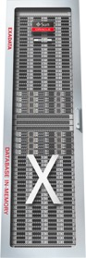
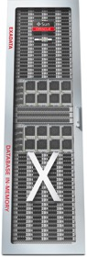



Exadata Deployment Models
On-Premises
Cloud at Customer
Public Cloud Service
X7-2
X7-8
Customer Data Center
Purchased
Customer Managed
Customer Data Center
Subscription
Oracle Managed
Oracle Cloud
Subscription
Oracle Managed

Slide 6
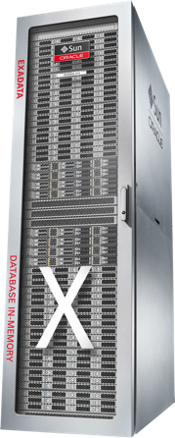
Introducing Exadata X7 State-of-the-Art Hardware Integrated with Smart Database Software

Slide 7
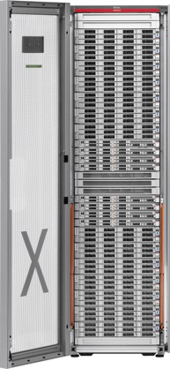

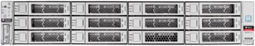
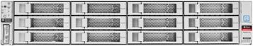
Exadata Database Machine X7-2
State-of-the-Art Hardware
Scale-Out Database Servers
Fastest Internal Fabric
Scale-Out Intelligent Storage
High-Capacity Storage Server
Extreme Flash Storage Server
2 socket Xeon processors
48 cores per server
384 GB - 1.5 TB DRAM
40 Gb/s InfiniBand internal network
25/10/1 GigE external network
120 TB disk capacity (10 TB helium disks)
25.6 TB PCI NVMe Flash
20 cores for SQL offload
51.2 TB PCI NVMe Flash
20 cores for SQL offload

Slide 8
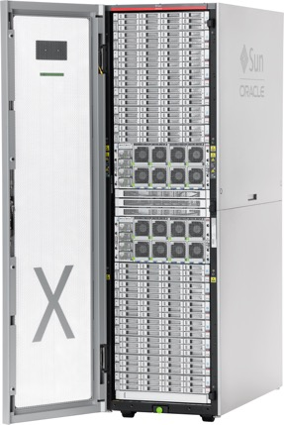
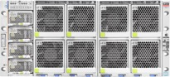
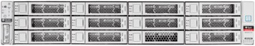
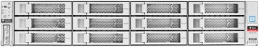
Exadata Database Machine X7-8
Scale-Out Database Servers
8-socket x86 processors
192 cores
3-6 TB DRAM
Fastest Internal Fabric
Scale-Out Intelligent Storage
High-Capacity Storage Server
Extreme Flash Storage Server
Large SMP Processor Model
Big data warehouses
Massive database consolidation
In-Memory databases
Same Networking, Storage and Software as X7-2
40 Gb/s InfiniBand
25/10/1 GigE external connectivity
120 TB disk capacity (10 TB helium disks)
25.6 TB PCI NVMe Flash
20 cores for SQL offload
51.2 TB PCI NVMe Flash
20 cores for SQL offload

Slide 9
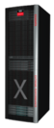
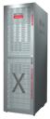
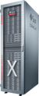
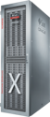
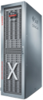
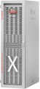
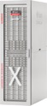
Database Platform Leadership Since 2008
V1
V2
X2
X3
X4
X5
X6
X7
V1 – X7 Growth
Storage (TB) | 168 | 336 | 504 | 504 | 672 | 1344 | 1344 | 1.68 PB | 10 X
Flash Cache (TB) | 0 | 5.3 | 5.3 | 22.4 | 44.8 | 89.6 | 179.2 | 358 TB | 64 X
CPU (cores) | 64 | 64 | 96 | 128 | 192 | 288 | 352 | 384 cores | 6 X
Max Mem (GB) | 256 | 576 | 1152 | 2048 | 4096 | 6144 | 12288 | 12 TB | 48 X
Ethernet (Gb/s) | 8 | 24 | 184 | 400 | 400 | 400 | 400 | 800 Gb/s | 100 X
Scan Rate (GB/s) | 14 | 50 | 75 | 100 | 100 | 263 | 301 | 350 GB/s | 25 X
Read IOPS (M) | .05 | 1 | 1.5 | 1.5 | 2.66 | 4.14 | 5.6 | 5.97 M | 120 X

Slide 10
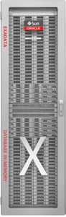
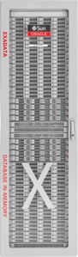
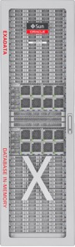

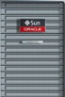
Configure Servers to Match Your Workload
Elastic Hardware Configurations
Add racks to continue scaling*
* Expand older racks with new servers and multi-rack old and new racks together
Eighth to Qtr Upgrade
Add Servers as needed*
X7-2 Eighth Rack
Quarter Rack
Full Rack
X7-8 Elastic Configuration
Capacity-on-Demand Software Licensing
Enable compute cores as needed, subject to minimums
License Oracle software for enabled cores only
14 cores minimum per DB server (max 48 cores)
8 cores minimum per Eighth Rack DB server (max 24 cores)

Slide 11
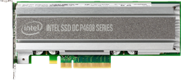
Hot Swappable Hardware for Online Maintenance
Flash
Disks
M.2 boot drive
Power supplies
Fans
InfiniBand switch
Not Hot Swappable:
PCI cards (network, IB, HBA), CPU, Memory (bad sectors will be disabled)

Slide 12
Exadata Smart Software Unique Differentiators for Analytics, OLTP and Consolidation

Slide 13





Exadata Unique Smart Database Software Highlights
Smart Analytics
Move queries to storage, not storage to queries
Automatically offload and parallelize queries across all storage servers
Extend In-Memory DB with flash
Run In-Memory DB on standby
10x – 100x faster analytics
Smart Storage
Hybrid Columnar Compression reduces space usage by 10x
Database-aware Flash Caching gives speed of flash with capacity of disk
Storage Indexes eliminate unnecessary I/O
Smart OLTP
Special InfiniBand protocol enables 3x faster OLTP messaging
Ultra-fast DB-optimized flash logging
Instant detection of node failure and I/O issues
Smart Consolidation
Critical DB messages jump to head of queue for ultra-fast latency
CPU, I/O, network resources prioritized for end-to-end quality of service
4x more databases vs same hardware without Exadata software

Slide 14

Dozens of Additional Smart Database Capabilities
Smart Analytics
Storage Index data skipping
Storage offload for min/max operations
Data mining storage offload
Storage offload for LOBs and CLOBs
Auto flash caching for table scans
Reverse offload to DB servers
Offload index fast full scans
Offloads scans on encrypted data, with FIPS compliance
Active bonding of InfiniBand
Instant data file creation
Smart OLTP
Smart network packet prioritization
I/O Prioritization by DB, User, or workload to ensure QOS
Active AWR includes storage stats for end to end monitoring
Write-back Flash Cache
Cell-to-cell rebalance preserving Flash Cache
Secure disk and flash erase
Database scoped security
Full-stack security scanning
Exachk full-stack validation
NVMe flash interface for lowest latency I/O
Smart Availability
In-Memory fault tolerance
Offload backups to storage
Prioritize rebalance of critical files
Elimination of false drive failures
Flash and disk life cycle mgmt alert
Avoid reading predictive failed disks
Cell software transparent restart
I/O hang hardening
Prevent shutdown if mirror server is down
Confinement of temporarily poor performing drives

Slide 15
Best Performance

Slide 16
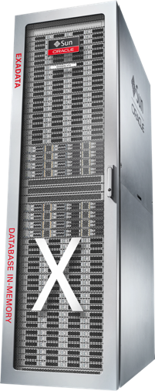
Exadata X7-2 and X7-8 Performance Improvements
350 GB/sec I/O Throughput
17% more (vs Exadata X6)
5.97 Million OLTP Read IOPS
50% more IOPS (vs Exadata X6) under 250 µsec = 3.5M
40% CPU improvement for Analytics
20% CPU improvement for OLTP
40% on X7-8 (vs Exadata X6-8)
Dramatically faster than leading all-flash arrays in every metric
Each rack has up to:
1.7 PB Disk
720 TB NVMe Flash
Notes:
SSB DBM mentiones as In-Memory Analytic Benchmark

Slide 17
Best Data Warehouse

Slide 18
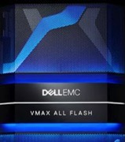

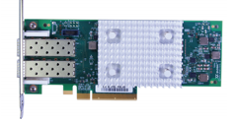
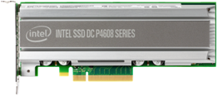
Latest Flash Creates Giant Bottleneck for Shared Storage
Latest PCIe Flash 5.5 GB/sec
SAN Link = 40 Gb/s 5 GB/sec
Less than 1 Flash card
480 Flash Drive EMC Array
38 GB/sec
But Should Achieve
5.5GB * 480 Drives = 2,640 GB/sec
Notes:
VMAX 950 F 2 V Brick
8 Vbricks ~ 150 GB/s
2 Vbricks = 37.5 GB/s
Each Vbrick has 240 drives
2 Vbricks = 480 drives

Slide 19
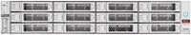
Exadata Approaches Memory Speed with Shared Flash
Exadata DB Servers
Architecturally, storage arrays can share Flash capacity but not Flash performance
Even with next gen scale-out, PCIe networks, or NVMe over fabric
Network is the bottleneck
Must move compute to data to achieve full Flash potential
Requires owning full stack; can’t be solved in storage alone
Exadata X7 delivers 350 GB/s Flash bandwidth to any server
Approaches 800 GB/s aggregate DRAM bandwidth of DB servers
InfiniBand
Query Offload
Exadata
Smart Storage

Slide 20




Exadata Smart Scan
Move Queries to Data, Not Data to Queries
What were my sales on Jan 22?
Optimizer chooses access plan
Exadata Database Servers
SELECT SUM(sales) WHERE date=‘22-Jan-2016’
Sum
Scanning and filtering executes locally in storage
Return only sales amounts for Jan 22
10 TB scanned
100 GB returned to servers
Exadata Smart Storage Servers

Slide 21
Benefits of Exadata Smart Scan
Intelligent storage reduces communication traffic by orders of magnitude
Eliminates all three bottlenecks: getting data out of storage, across SAN, and into any server
CPU cost of scanning, decrypting, decompressing, filtering, and projecting data is offloaded to storage
Queries are parallelized across all storage servers for further speedup
End result is Exadata achieves over 300 GB/s query throughput from flash per rack
Dramatically more than fastest all-flash scale-out storage

Slide 22
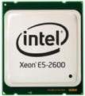

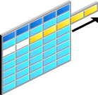
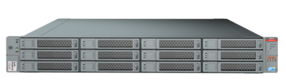
Exadata Smart Scan – Not Just Query Offloading
Exadata storage servers run complex operations in storage
Row filtering based on “where” predicate
Column filtering
Join filtering
Incremental backup filtering
I/O prioritization
Storage Indexing
Database level security
Offloaded scans on encrypted data
Smart File Creation
10x reduction in data sent to DB servers is common
Exadata Storage Servers

Slide 23
What can’t be off-loaded?
Most table scans are off-loadable
Limitations on large number of columns for row-major tables
In 11.2, no LOBs
Inline LOBs are supported in 12.1
Functions that need RDBMS support
PL/SQL, system functions, aggregates, analytics
v$sqlfn_metadata, offloadable = ‘NO’
BUT still get some benefit from offload if some offloadable predicates
Also with no predicates but few columns selected
Even Select * with HCC because decompression is offloaded

Slide 24
Storage Index - Motivation
Smart Scans:
DB sends list of table extents along with the predicate to the Exadata storage cells
Exadata cells read the table extents, apply predicate on the read data and only return back filtered results
Network IO (as perceived by Database) is reduced drastically – DB CPU usage also reduces
But we are still performing disk IO on Exadata storage cells
Can we reduce disk IO too ?
A | B | C | D
 | 3
 | 1
 | 2
 | 9
 | 8
 | 8
 | 6
 | 7
 | 5
Min B = 1
Max B = 3
Min B = 8
Max B = 9
Min B = 5
Max B = 7
Select * from table where B=6

Slide 25
Storage (Anti)- Index
Storage Index helps filter out data on disk (whereas Index helps find data)
Array on –in-memory entries (called region Indexes)
Each region index stores column summaries (eg min/max) for 1MB region on disk
Transparent to the database and maintained automatically
Min/Max can help eliminate IOs if data cannot match the where clause
Region Index
A | B | C
9 | 3
10 | 1
8 | 2
11 | 9
10 | 8
10 | 8
A | B | C | D
 | 3
 | 1
 | 2
 | 9
 | 8
 | 8
 | 6
 | 7
 | 5
Min B = 1
Max B = 3
Min B = 8
Max B = 9
Min B = 5
Max B = 7
Select * from table where B=6

Slide 26
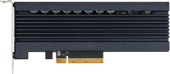
Exadata Smart Flash Cache
Understands different types of I/Os from database
Skips caching I/Os to backups, data pump I/O, archive logs, tablespace formatting
Caches Control File Reads and Writes, file headers, data and index blocks
Immediately adapts to changing workloads
Unlike tiering that relies on historical statistics and is slow to move
Tiering caches yesterday’s hot data not today’s
Tiering uses large chunks (1MB) while cache responds faster with 64KB chunks
Write-back flash cache
Caches writes from the database not just reads
RAC-aware from day one
Doesn’t need to mirror in flash for read intensive workloads

Slide 27
Exadata I/O Elimination

Slide 28



Exadata Minimizes I/O - Dramatically Improves Performance
SELECT SUM(amount) WHERE salesdate= ‘22-Jan-2016’…
❶
SQL offload to storage
❶
Partition 1
Salesdate
Salesdate
Amount
Amount
Partition N
22012016
1500.75
10 Terabyte Table (100 billion rows)
22012016
525.20

Slide 29
Exadata Minimizes I/O - Dramatically Improves Performance
SELECT SUM(amount) WHERE salesdate= ‘22-Jan-2016’…
❶
SQL offload to storage
Partition pruning
❶
❷
Partition 1
❷
Salesdate
Amount
Partition N
22012016
1500.75
10 Terabyte Table (100 billion rows)
22012016
525.20

Slide 30
Exadata Minimizes I/O - Dramatically Improves Performance
SELECT SUM(amount) WHERE salesdate= ‘22-Jan-2016’…
SQL offload to storage
Partition pruning
Storage Index data skipping
❶
❶
❷
❸
Partition 1
❷
Salesdate
Amount
Salesdate
Amount
Partition N
22012016
1500.75
❸
10 Terabyte Table (100 billion rows)
22012016
525.20

Slide 31

Exadata Minimizes I/O - Dramatically Improves Performance
❹
❶
SQL offload to storage
Partition pruning
Storage Index data skipping
Smart Scan filtering
❶
Smart Scan
Row / Column Filtering
Return 100 Bytes
❷
❸
Partition 1
❷
Salesdate
Salesdate
Amount
Amount
❹
Partition N
22012016
1500.75
❸
10 Terabyte Table (100 billion rows)
22012016
525.20

Slide 32

Benefits Multiply with Parallel Architecture
SELECT SUM(amount) WHERE salesdate= ‘22-Jan-2016’…
Exadata Scale-Out Storage

Slide 33

Exadata Flash Delivers Lowest Latency in the Industry
SELECT SUM(amount) WHERE salesdate= ‘22-Jan-2016’…
12.8 TB Flash Cache
NVMe
12.8 TB Flash Cache
12.8 TB Flash Cache
NVMe
36 TB Disk Usable Capacity
36 TB Disk Usable Capacity
36 TB Disk Usable Capacity
Smart Flash Cache algorithms optimize flash capacity based on type of I/O

Slide 34


Exadata Compared to Best of Breed Database Platforms
SELECT SUM(amount) WHERE salesdate= ‘22-Jan-2016’…
Database Servers
NO SQL offload to storage
Partition pruning (DB function)
NO Storage Index data skipping
NO Smart Scan filtering
NO scale-out storage
NO smart flash
❶
❷
❸
❹



Slide 35
Columnar Formats Are Great for Analytics and Compression
Columnar format stores the data in each column together rather than the data in each row
Columnar format is great for Analytics
Enables fast scans of columns relevant to a query
Columnar format is great for Compression
Values within a column are much more similar than across
Pure Columnar format is horrible for Random Row Access
Requires an I/O for each column in a row rather than a single I/O for the entire row
100x slower random row access – Columnar Cliff
City
First Name
Country
Last Name
Department
Column Format Data

Slide 36
Hybrid Columnar Compression Overview
Organize columns into sets of a few thousand rows
Compression Units (CUs)
Within CU, data is organized by column, then compressed
Get all the compression benefits of full columnar format
For analytics, compression greatly reduces I/O, and the columnar format reduces CPU
Each CU is small enough to be read from storage in a small number of I/O operations (usually 2)
Random row access requires one or two I/Os per row, instead of one I/O for each column
Column 1
Column 4
Column 2
Column 5
Column 3
CU
Column 1
Column 4
Column 2
Column 5
Column 3
CU
Column 1
Column 4
Column 2
Column 5
Column 3
CU

Slide 37
Benefits of Hybrid Columnar Compression
Hybrid Columnar Compression achieves great space and IO reductions
Typical compression ratio of 10x
Exadata storage offloads decompression, enabling better compression algorithms
Fast random row access on columnar data enables:
Historical data to be cost-effectively kept in OLTP databases
Fast drilldown to row level for analytics
Retailers
Financial Services
Telcos

Slide 38

Hybrid Columnar Compression
Business as Usual
Fully supported with…
B-Tree, Bitmap Indexes, Text indexes
Materialized Views
Exadata Server and Cells including offload
Partitioning
Parallel Query, PDML, PDDL
Schema Evolution support, online, metadata-only add/drop columns
Data Guard Physical Standby Support

Slide 39
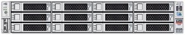
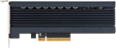

Compression Benefits Multiply Across Stack
10x less Storage
Storage Array Compression Only Achieves a Fraction of These Benefits
10x better Disk Bandwidth
10x more data in Flash Cache
10x more data in Database DRAM Cache
Test
Dev
DR
10x smaller Test DB, Dev DB, DR DB
10x smaller Backup

Slide 40



Seamless Integration of Big Data, NoSQL and Relational Data
Data Warehouses are being supplemented by specialized Multi-model Big Data stores
Creates silos of isolated data and incompatible access
Oracle Big Data SQL provides Transparent, Massively Parallel Queries across Oracle, NoSQL and Hadoop/Spark
Full Oracle SQL capabilities across data stores
Much faster and more expressive than Hadoop/Spark
Big Data SQL
Pushes Data Filtering to Each Store
Like Exadata Smart Scan
Not restricted to Oracle Hardware

Slide 41
Best OLTP

Slide 42


Typical OLTP IO Path
RDBMS
RDBMS
Cache Fusion
OS
OS
NW Stack
NW Stack
Device Drivers
Device Drivers
HBA/NIC
HBA/NIC
SAN/LAN
SCSI
Switch Fabric
Storage Controller
Storage Controller
Storage Controller SW
Storage Controller SW
Proprietary Protocols and/or SCSI
Persistent
Storage
Hardware View
Software View

Slide 43
Traditional Networking Stacks Delay OLTP Messages
OLTP messages are small and relatively simple, so they require little time to transfer over the network and execute on the destination
Most of the processing time for OLTP messages is due to the CPU and OS overhead of traversing the complex multi-layer network protocol stack
Both on the source and destination
Database
Network Stack
Hardware

Slide 44
Exafusion Direct-to-Wire Protocol
Exafusion is a light-weight datagram oriented protocol custom designed for critical OLTP messages on Exadata’s OS, firmware, and InfiniBand hardware
Exafusion does not need to support other message types or hardware stacks
Therefore is able to call InfiniBand hardware directly, bypassing networking stack
Database
Network Stack
Hardware

Slide 45

Mixed Workload Degrade OLTP Response Times
Only OLTP
OLTP often runs concurrently with high throughput workloads
Database consolidation, batch, real-time analytics, reporting, backups
However, high throughput workloads can severely degrade OLTP
They create long network queues, delaying critical OLTP messages
Mixed Workload
Notes:
How to ignore blocks based on the values of any column?
Without introducing overhead
Hint: partition/indexing help with only 1 column

Slide 46
Exadata Network Resource Management
Database tags messages that require low-latency
Log writes, cache-fusion messages, locks, etc.
Low-latency messages bypass all other messages
Reporting, backups, batch, etc.
Even partially sent messages are bypassed
Exadata accelerates low-latency messages in all layers: database, network cards, switches, and storage
Otherwise bottleneck just moves
BYPASS LANE

Slide 47
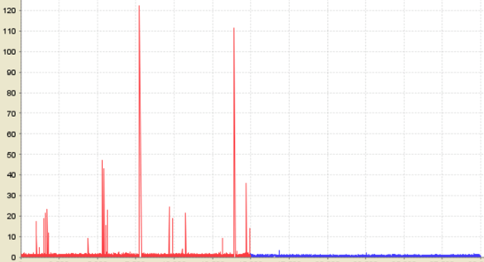
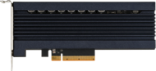
Exadata Smart Flash Log
Smart Flash Log uses flash as a parallel write cache to disk controller cache
Whichever write completes first wins (disk or flash)
Reduces response time and outliers
“log file parallel write” histogram improves
Greatly improves “log file sync”
Uses almost no flash capacity (< 0.1%)
Completely automatic and transparent
Smart Logging = Off
Smart Logging = On
Outliers
Txn Response Time (ms)
Outliers
Outliers
No Outliers
Parallel
Log Writes
(first wins)

Slide 48

Transferring Hot Database Blocks Slows OLTP
OLTP workloads can have hot blocks that are frequently updated
Before transferring a block between nodes, all changes to the block must be written to the log
Ensures changes are not lost due to a node crash
Waiting for a log write to complete delays critical OLTP communication
1. Issue log write
3. Transfer block
2. Wait for log write completion

Slide 49
New: Smart Fusion Block Transfer
Exadata eliminates the wait for log write completion before transferring a block
Destination node can modify block but will wait at commit time if log write has not completed
Enabled by Exadata’s unique tracking of log writes across nodes
1. Issue log write

3. Transfer block
2. Wait for log write completion
Exadata Avoids I/O Wait

Slide 50
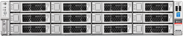
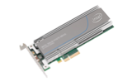
OLTP: Exadata Brings In-Memory OLTP to Storage
Compute
Server
Exadata Storage Servers add a memory cache in front of Flash memory
Similar to current Flash cache in front of disk
Cache is additive with cache at Database Server
Only possible because of tight integration with Database
2.5x Lower latency for OLTP IO – 100 usec
Up to 21 TB of DRAM for OLTP acceleration with Memory Upgrade Kit
Compare to 5TB of flash in V2 Exadata
Storage Server
DRAM
Hot
Flash
Warm
Disk
Cold

Slide 51
In-Memory OLTP Acceleration – Journey of a Database Block
In-Memory OLTP Cache
Flash Cache
Hard Disk Drive
DB Buffer Cache
Hard Disk Drive
Flash Cache
DB Buffer Cache
In-Memory OLTP Cache
Database Server
Storage Server
1. DB reads a block
Data initially resides on hard disk
Exadata Serves the Block from Storage

Slide 52
In-Memory OLTP Acceleration – Journey of a Database Block
In-Memory OLTP Cache
Flash Cache
Hard Disk Drive
DB Buffer Cache
Hard Disk Drive
Flash Cache
DB Buffer Cache
In-Memory OLTP Cache
Database Server
Storage Server
2. Flash Cache Gets
Populated

Slide 53
In-Memory OLTP Acceleration – Journey of a Database Block
In-Memory OLTP Cache
Flash Cache
Hard Disk Drive
DB Buffer Cache
Hard Disk Drive
Flash Cache
DB Buffer Cache
In-Memory OLTP Cache
Database Server
Storage Server
3. Database evicts
the block
Exadata Caches the block in In-Memory OLTP Cache

Slide 54
In-Memory OLTP Acceleration – Journey of a Database Block
In-Memory OLTP Cache
Flash Cache
Hard Disk Drive
DB Buffer Cache
Hard Disk Drive
Flash Cache
DB Buffer Cache
In-Memory OLTP Cache
Database Server
Storage Server
4. Database reads the
same block again
Exadata serves the block from In-Memory OLTP Cache with 100us latency

Slide 55
In-Memory OLTP Acceleration
In-Memory OLTP Cache
Flash Cache
Hard Disk Drive
DB Buffer Cache
Hard Disk Drive
Flash Cache
DB Buffer Cache
In-Memory OLTP Cache
Database Server
Storage Server
Data is never in DB Buffer Cache or In Memory OLTP Cache at the same time

Slide 56
Best Consolidation

Slide 57
Consolidation Challenges
Database users apprehensive about consolidation
Demand performance guarantees
Workload surges from one application can affect others
Excessive CPU, memory, or I/O usage
Surges can originate from heavy application usage or a single runaway query
DBAs want to control resource usage
Fair access to resources
Hosted environments – “get what you pay for”

Slide 58













Resource Management for Consolidated Workloads
Prioritize System Resources by Database, Workload and Time of Day
Instance Caging
Limits a database instance to a maximum number of CPUs
Prevents resource hogging when consolidating databases
CPU Resource Management
Allocates CPU across different databases
Allocates CPU across workloads within a database
Implements parallel execution policies
Prevents runaway queries
Network Resource Management
Automatically prioritizes critical messages on InfiniBand fabric
Log writes, RAC cluster messages, etc.
I/O Resource Management (IORM)
Prioritizes I/O for critical workloads over non-critical workloads
Allows fair sharing for database consolidation
ETL
BATCH
TXNS
RPTS
AD-HOC
BACKUPS
WAREHOUSE
OLTP
PRIORITY LANE
I/O
I/O
I/O

Slide 59
Exadata’s Secret Sauce
Ordinary Storage
I/O
I/O
I/O
I/O
I/O
I/O
I/O
On ordinary storage, all I/Os look the same. Their only properties are their size, read vs write, and their file.

Slide 60
Exadata’s Secret Sauce
Exadata Storage
Buffer Cache read for OLTP transaction, PDB #2
LGWR redo write
Buffer Cache read for OLTP transaction, PDB #3
DBWR write to resolve “free buffer wait”
Table scan from Critical Data Warehouse
DBWR write - no threat of “free buffer wait”
Table scan read from Ad-Hoc Query Consumer Group / Service
On Exadata storage, each I/O is tagged with:
Who issued it
What it’s for
Its priority

Slide 61
Exadata’s Secret Sauce
Medium-priority I/O.
Stage to flash.
Prioritize against other user I/Os, based on resource plan.
High-priority I/O. Accelerated via Exadata Flash Log!
Exadata Storage
Buffer Cache read for OLTP transaction, PDB #2
Urgent – users are blocked. IORM prioritizes this I/O
LGWR redo write
Buffer Cache read for OLTP transaction, PDB #3
DBWR write to resolve “free buffer wait”
Table scan from Critical Data Warehouse
DBWR write - no threat of “free buffer wait”
Table scan read from Ad-Hoc Query Consumer Group / Service
High-priority query. IORM prioritizes against other scans
on both flash and disk!
Low-priority, resource-intensive query. Stage to flash, only if there’s room.
De-prioritize disk or flash I/O.
Not urgent – plenty of free buffers. IORM de-prioritizes this I/O

Slide 62
Exadata Smart Storage
The Philosophy
OLTP
SCANS
Disk
Flash
Flash offers great low latency.
Its priority should be OLTP.
Most OLTP I/Os should be serviced from flash.
Some OLTP I/Os will be serviced from disk, due to flash cache misses, slow flash log writes.
On flash, scans should be 2nd class citizens to OLTP for both bandwidth and space.
On disk, scans are extremely resource intensive and need to be regulated.

Slide 63
Exadata Smart Storage
IORM’s Role
OLTP
SCANS
Disk
Flash
IORM enforces how flash space is shared by databases.
IORM controls the impact of scans on OLTP flash latencies.
IORM enforces how the flash bandwidth is shared by databases for scans.
IORM controls the impact of scans on OLTP disk latencies.
IORM enforces how the disk bandwidth is shared by databases and workloads.

Slide 64
Best Availability

Slide 65

Exadata Maximum Availability Architecture (MAA)
Blueprint for HA: Designed and Tested to Handle All Failure Scenarios
Within Exadata
Within a Site
Across Sites
Redundant Hardware
Local standby for HA Failover
Remote standby for Disaster Recovery
Servers, Disks, Flash, Network, Power
Redo-based change replication with data consistency checking
Redundant Systems
Redundant Databases
Redundant Systems
Redundant Databases
Redundant
Software
Active clusters, Disk/flash mirroring
DATABASE IN-MEMORY
DATABASE IN-MEMORY
DATABASE IN-MEMORY
Online patching, reconfiguration, expansion
LAN
WAN
Fastest RAC Instance and Node Failure Recovery | Fastest Backup - RMAN Offload to Storage
Deep ASM Mirroring Integration | Fastest Data Guard Redo Apply | Complete Failure Testing with Lowest Brownouts

Slide 66
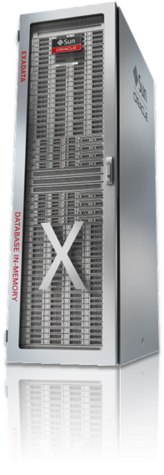


Fault Tolerant Availability
Only other AL4 Systems
IBM - z Systems
HPE - Integrity NonStop & Superdome
Fujitsu – GS & BS2000
NEC – FT Server/320 Series
Stratus ftServer & V Series
Unisys – Dorado
FIVE NINES 5X9 99.999%
“Exadata and SuperCluster both achieve AL4 fault tolerance in a Maximum Availability Architecture* configuration”
A New Gold Standard
*Gold or Platinum reference architecture

Slide 67
Better Monitoring and Manageability

Slide 68
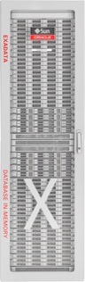

NEW: Automated Cloud Scale Software Updates
Automation updates all Exadata infrastructure software on full fleet
600+ components per full rack
Storage Server downloads new software in the background (18.1 release or later)
User schedules time of software upgrade
Storage Servers automatically upgrade in rolling fashion online or offline in parallel
Oracle Cloud updates hundreds of racks in a weekend
Server update times reduced
5x speedup in Storage Server updates
40% faster Database node update
More parallelism, fewer reboots
PARALLEL
ROLLING
Update Tool
FLEET UPDATES

Slide 69
Best Database Cloud

Slide 70
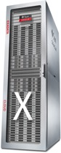
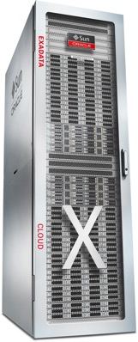



Exadata Cloud: Choice of Deployment Models
Flexible Subscription Model
Exadata Cloud at Customer (ExaCC)
In Customer Data Centers
Cloud Automation
Software Defined Networking
Exadata Public Cloud Service (ExaCS)
Cloud Security and Hardening
In Oracle Public Cloud Data Centers
Oracle-Managed Exadata Infrastructure
Core Exadata Platform

Slide 71
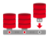
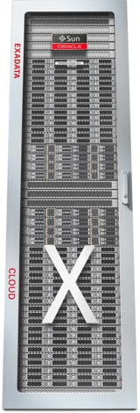

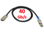
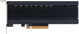


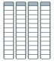
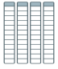



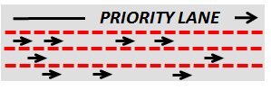




Exadata Cloud Enterprise Edition Extreme Performance Most Powerful Database + Platform
Multitenant
Offload SQL to Storage
In-Memory DB
InfiniBand Fabric
Real Application Clusters
Smart Flash Cache, Log
PCI Flash
Active Data Guard
Storage Indexes
Partitioning
All Oracle Database Innovations
All Exadata
DB Machine Innovations
Columnar Flash Cache
Advanced
Compression
Hybrid Columnar
Compression
HCC
10:1
Advanced Security, Label Security, DB Vault
I/O Resource Management
I/O
I/O
I/O
Real Application Testing
Network Resource Management
Advanced Analytics, Spatial and Graph
In-Memory Fault Tolerance
Management Packs for Oracle Database
Exafusion Direct-to-Wire Protocol

Slide 72
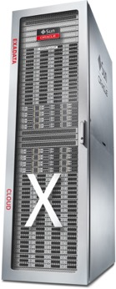





BYOL: Leverage On-Premises Licenses with Exadata Cloud
Multitenant
Active Data Guard
Partitioning
In-Memory DB
RAC
Transparent Data Encryption (TDE)
Diagnostics and Tuning Pack
Data Masking and Subsetting Pack
Real Application Testing
Legacy On-Premises Infrastructure
Notes:
Yes. When a customer brings a Database Enterprise Edition license entitlement to Oracle PaaS, they are granted the rights to use Diagnostics Pack, Tuning Pack, Data Masking and Subsetting Pack, and Real Application Testing without having on-premises license entitlements for those Database Options. Database BYOL to PaaS customers also have access to TDE and HCC. This a significant advantage for customers who BYOL to Oracle PaaS versus AWS IaaS or AWS RDS

Slide 73

Exadata Cloud at Customer
Available at customers’ data centers
Customer responsible for data center infrastructure
Oracle manages all Exadata infrastructure
Bringing the Oracle Cloud to you
Five ideal customer profiles
Subject to data regulatory, data sovereignty and data residency laws or policies
Apps require the throughput or latency of a local LAN rather than a WAN
Databases are too tightly-coupled with existing applications and infrastructure to move to public cloud
Want the benefits of a database cloud, but organizationally not ready to move to a public cloud
Need cloud deployments with familiar, on-premises security controls
Customer Data Centers
Notes:
Residency laws that require data to be stored within a corporate entity or a political territory, and not in a public cloud data center
Agility, simplicity, elasticity, and subscription based benefits of a database cloud

